Slide 1
8-12 Year Old Gift Guide

Slide 2
New for 2024 – Incentives
Dallas Metro is in need of 8-12 year old gifts
Most under purchased age range
2023: 320 children
2024: 360 children
For every $25 of value from the specified 8 to 12 year old categories, you will receive 1 free raffle ticket
Tips:
Look for age labels (Ex. 8+)
Review the 8-12 Year Old Gift Guide located on our holiday website
Final age and category approval will be determined by the Toy Donation Team
When in doubt, ask Brittney Sarabia!
8 to 12 Year Old Categories
Nerf Guns
Makeup Kits
Headphones
Mini Backpacks
Bluetooth Speakers
Remote Control Cars
Karaoke Microphones
More Challenging Lego & K'nex Sets

Slide 3
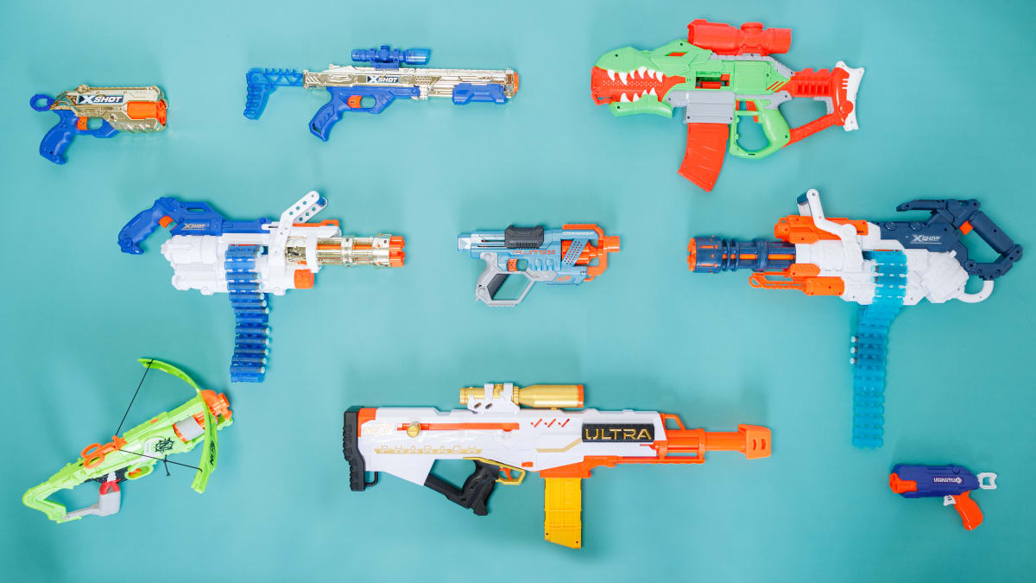
Nerf Guns
Most nerf guns are rated for this age range!

Slide 4
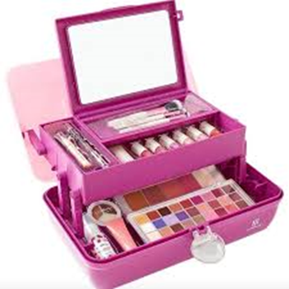
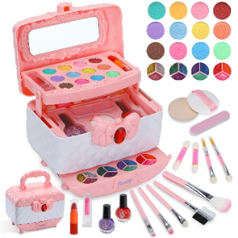
Makeup Kits
Brands: Ulta, Wet N Wild, Elf, Cover Girl, Maybelline, Revlon, Drug Store Brands, etc
Ulta, Walmart, Target, Ross, TJ Maxx, and Marshalls sell great makeup kits around the holidays

Slide 5
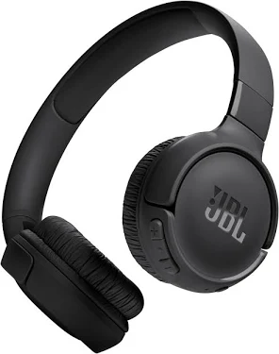
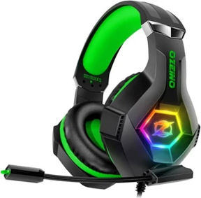
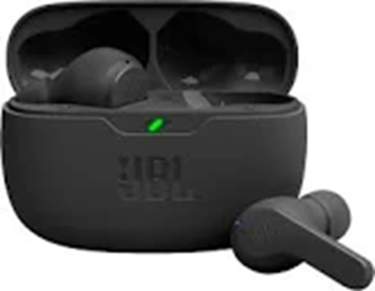
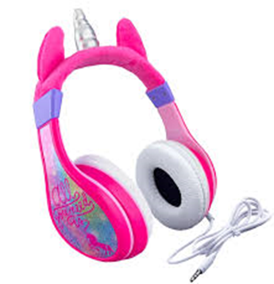
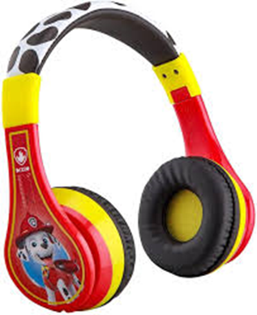
Headphones
Be aware if the product is labeled as Kids’ headphones as they could be too small for older children

Slide 6
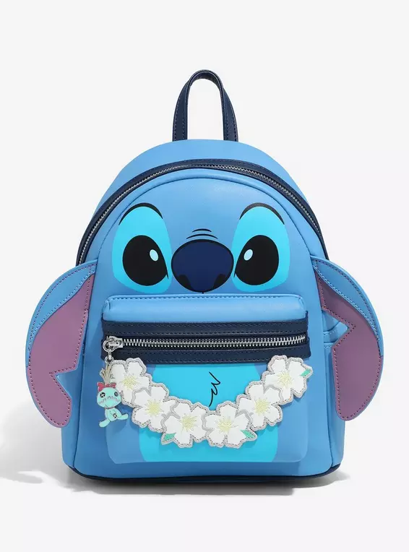
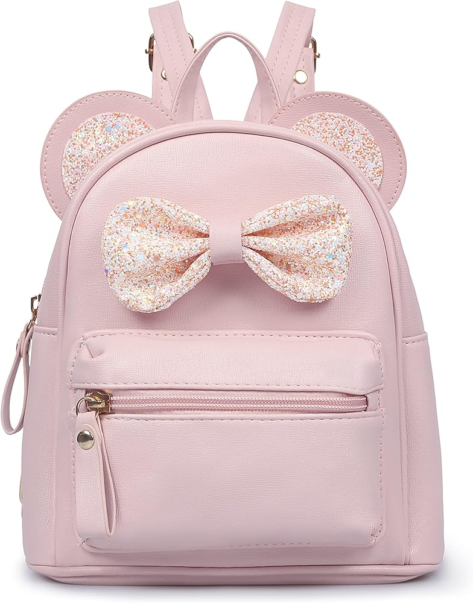
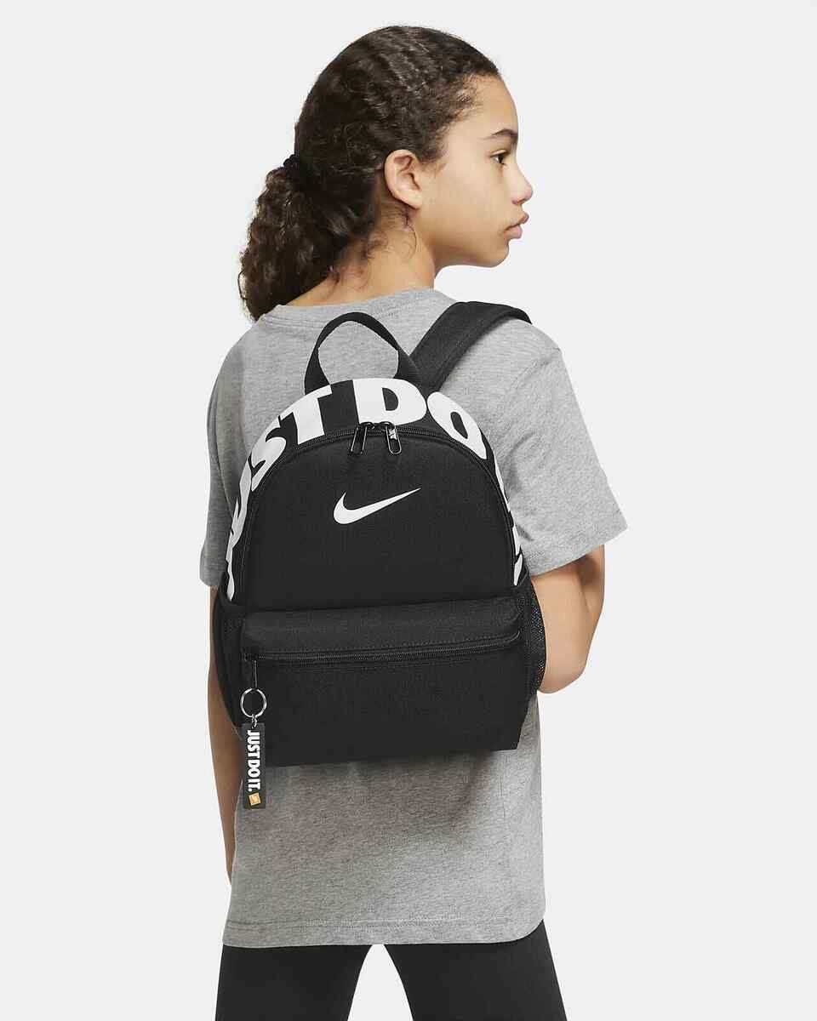
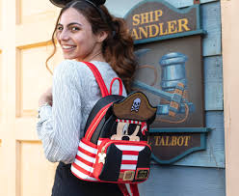
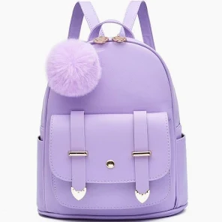
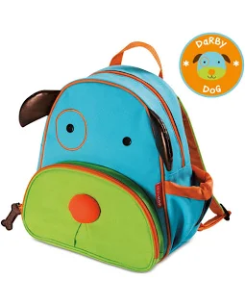
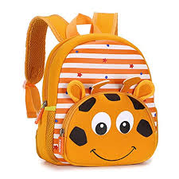
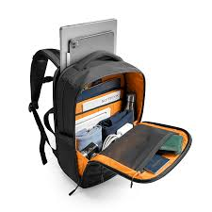
Mini Backpacks
Stores: BoxLunch, Hot Topic, Disney, Amazon, Claire’s, Walmart, Target, etc

Slide 7
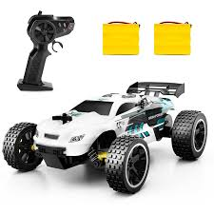
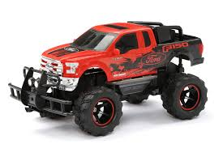
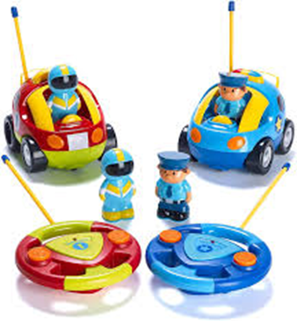
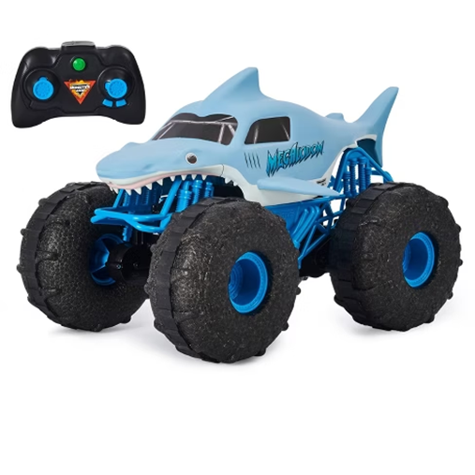
R/C Cars
Best to stay away from characters and
go with more realistic, futuristic, cool-looking

Slide 8
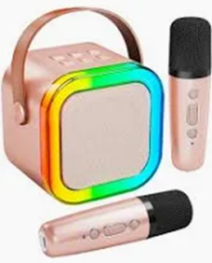
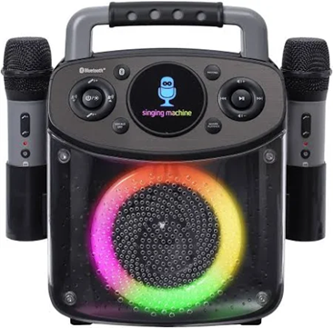
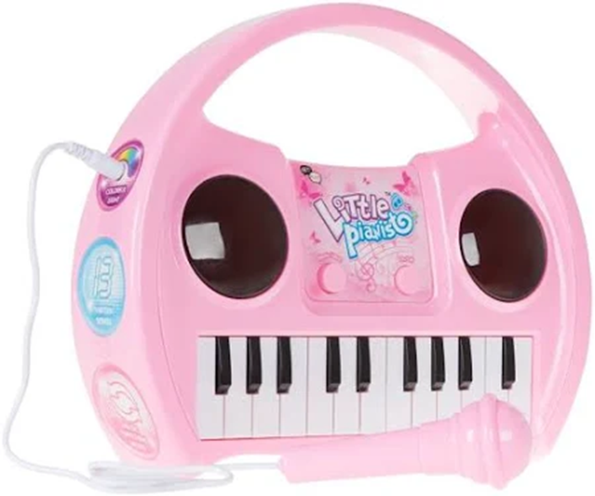
Karaoke Microphones

Slide 9
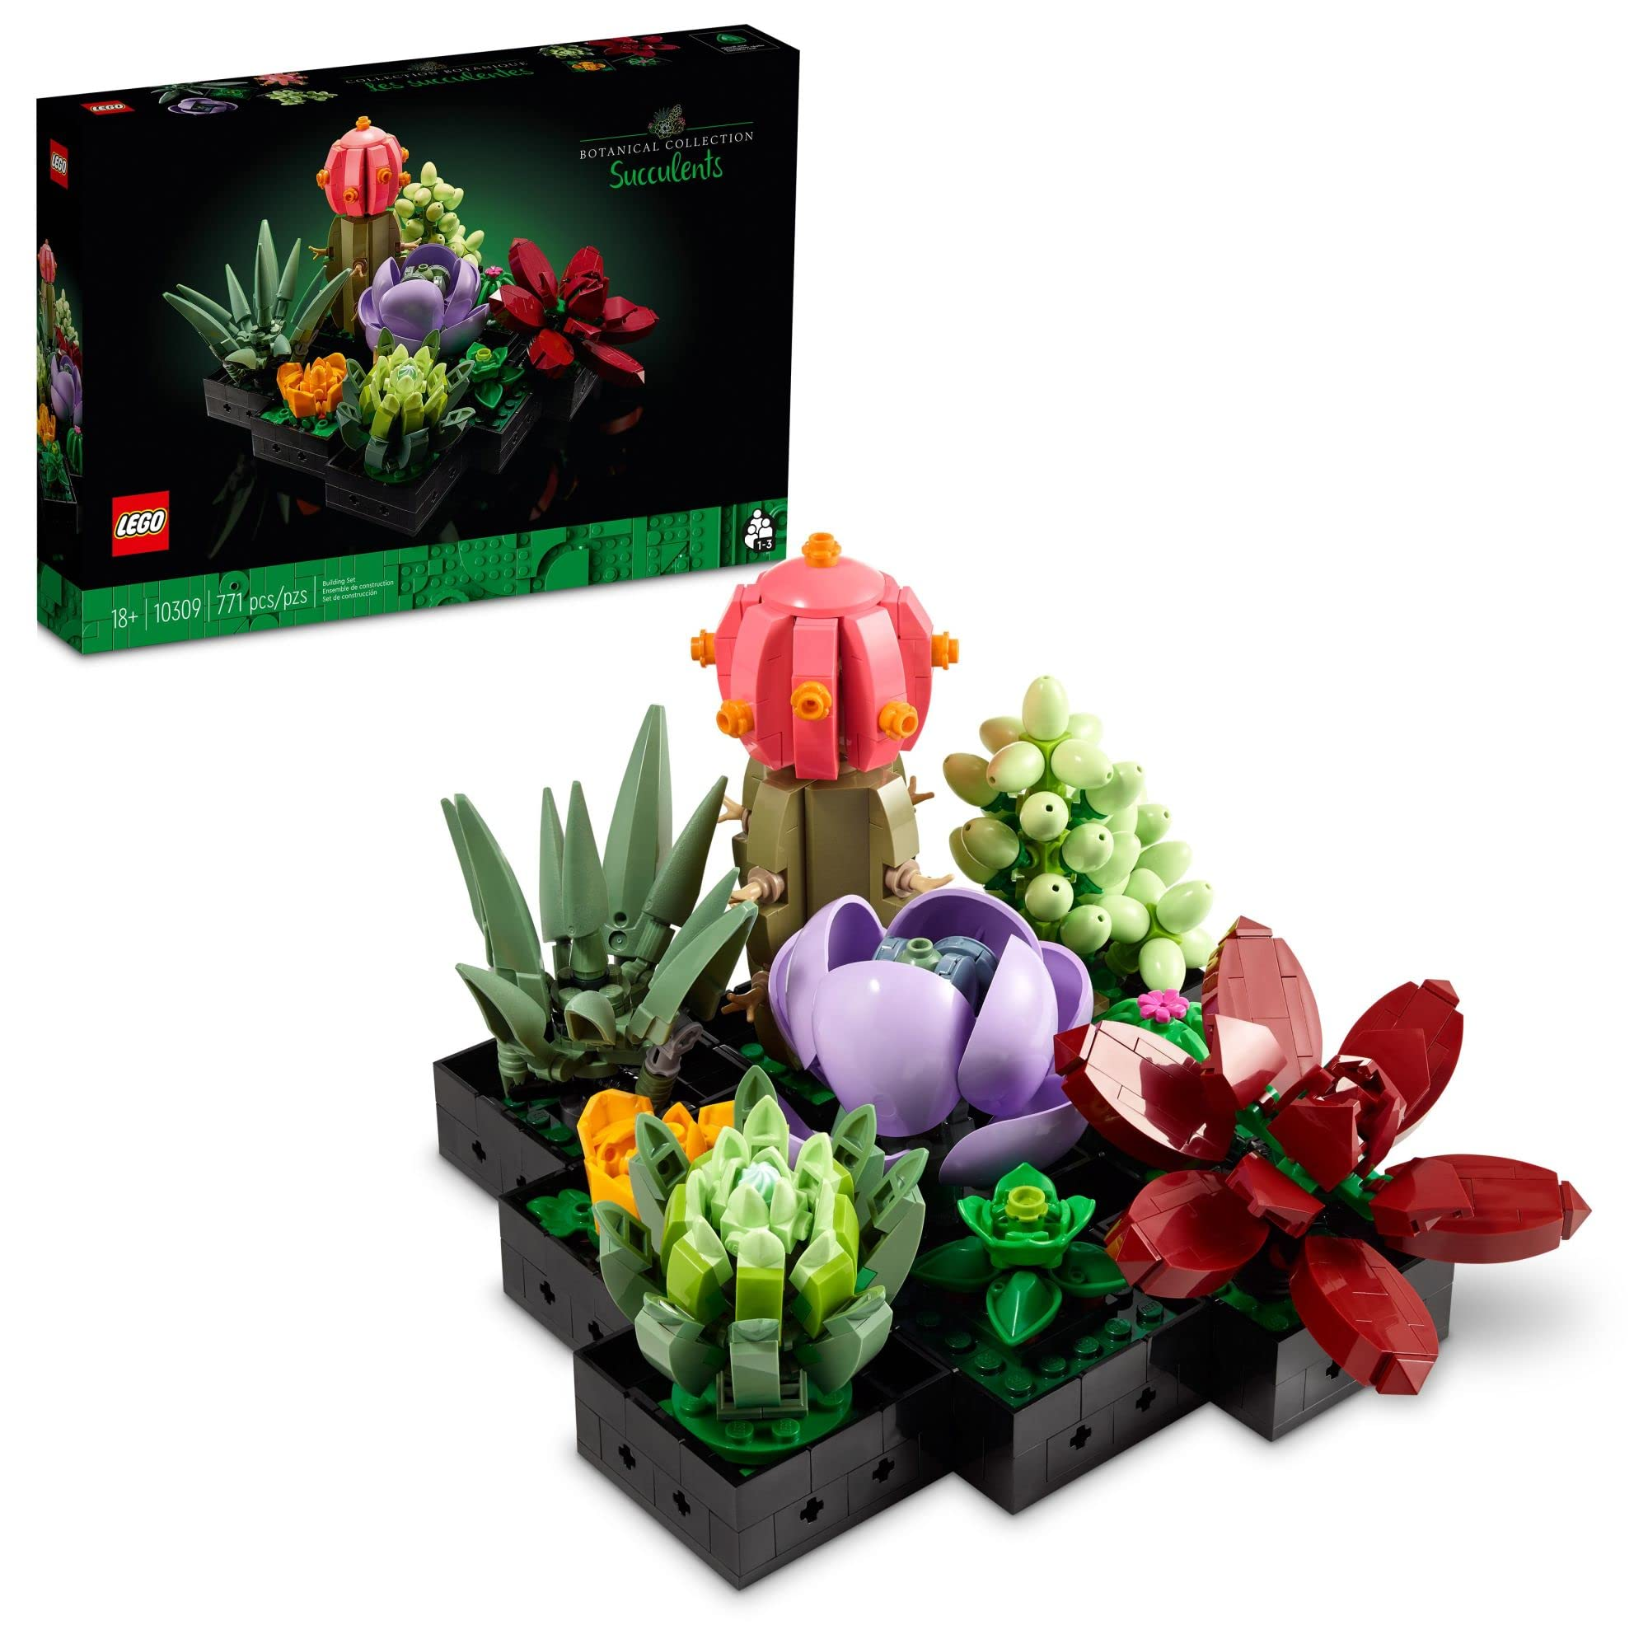
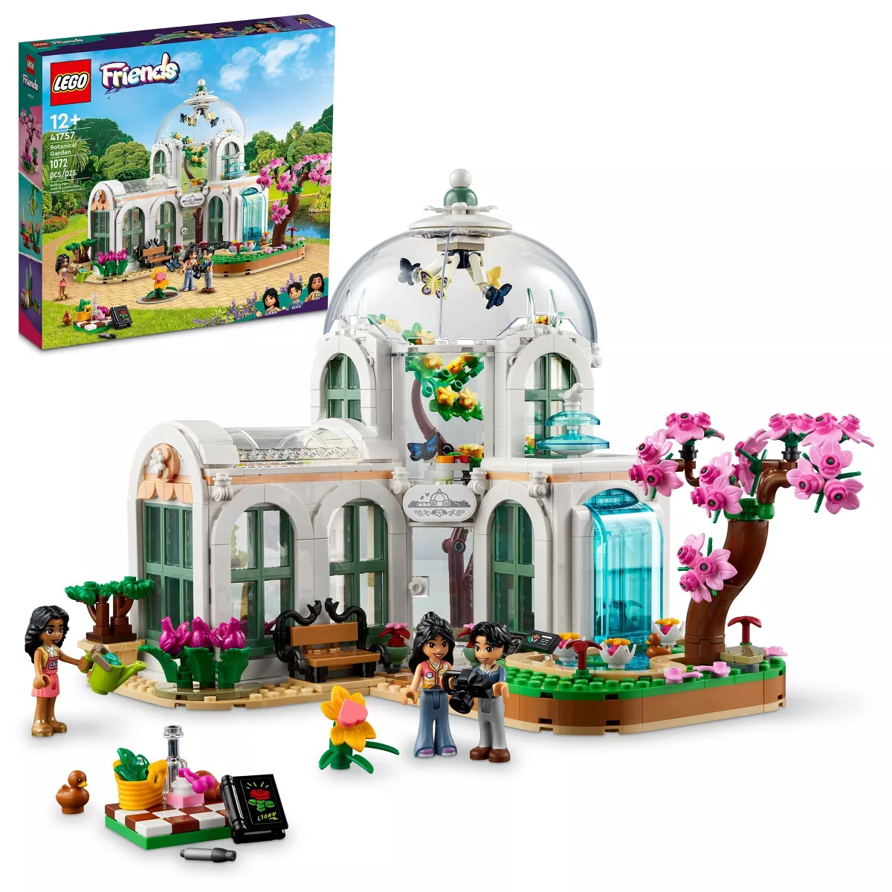
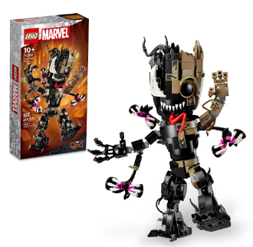
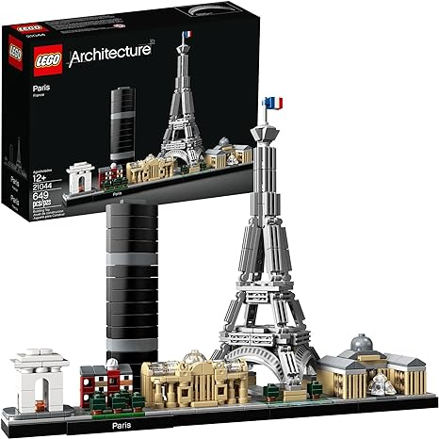
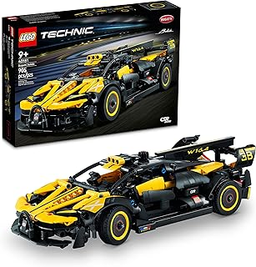
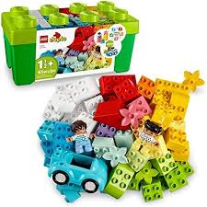
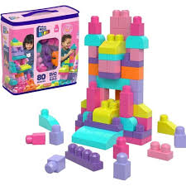
Lego Sets
Friends
Botanical
DC, Marvel, Star Wars,
Lord of the Rings, etc
Buildings &
Structures
Vehicles
Duplo
Megablocks

Slide 10
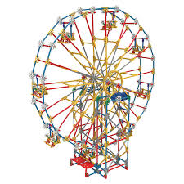
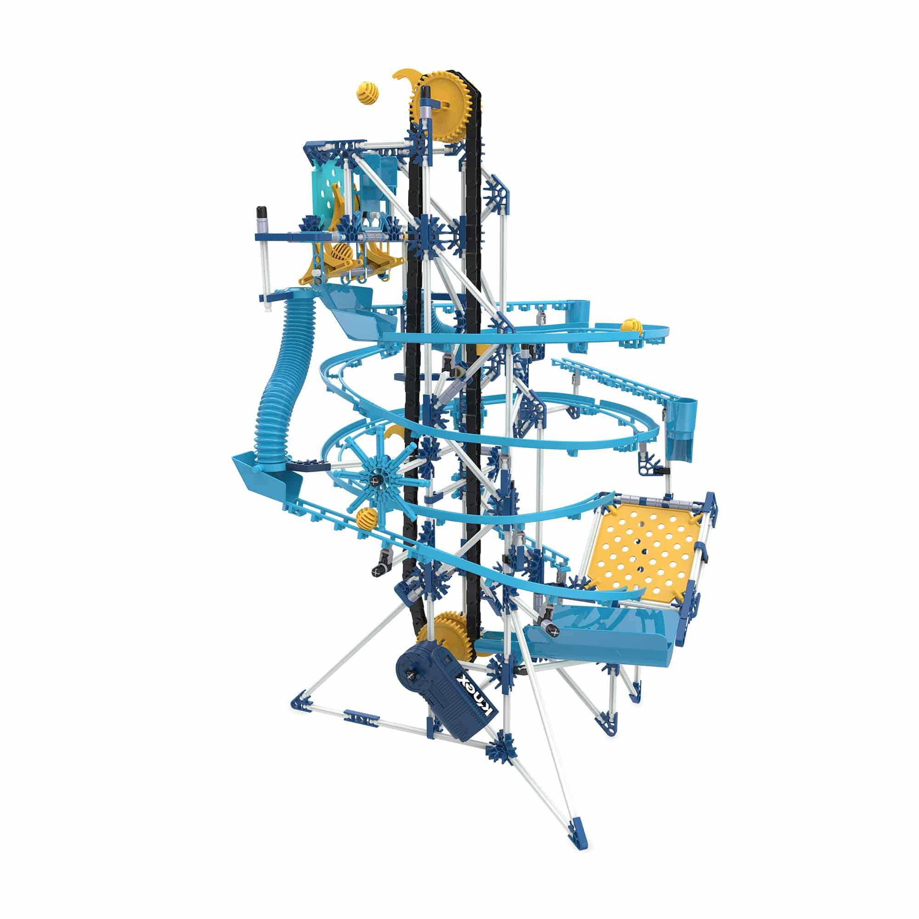
K’nex

